Slide 1
Cookies and Servlet

Slide 2
Cookies are text files stored on the client computer and they are kept for various information tracking purpose. Java Servlets transparently supports HTTP cookies.

Slide 3
There are three steps involved in identifying returning users −
Server script sends a set of cookies to the browser. For example name, age, or identification number etc.
Browser stores this information on local machine for future use.
When next time browser sends any request to web server then it sends those cookies information to the server and server uses that information to identify the user.

Slide 4
The Anatomy of a Cookie
Cookies are usually set in an HTTP header (although JavaScript can also set a cookie directly on a browser). A servlet that sets a cookie might send headers that look something like this −
HTTP/1.1 200 OK
Date: Fri, 04 Feb 2000 21:03:38 GMT Server: Apache/1.3.9 (UNIX) PHP/4.0b3
Set-Cookie: name = xyz;
expires = Friday, 04-Feb-07 22:03:38 GMT;
path = /; domain = tutorialspoint.com Connection: close Content-Type: text/html

Slide 5
<html> <body> <form action = "HelloForm" method = "GET">
First Name: <input type = "text" name = "first_name"> <br />
Last Name: <input type = "text" name = "last_name" />
<input type = "submit" value = "Submit" /> </form> </body> </html>

Slide 7
Cookie class
javax.servlet.http.Cookie class provides the functionality of using cookies. It provides a lot of useful methods for cookies.
Constructor of Cookie class
Cookie()=constructs a cookie.
Cookie(String name, String value)=constructs a cookie with a specified name and value.

Slide 8
Commonly used methods
public void setMaxAge(int expiry)=Sets the maximum age of the cookie in seconds.
public String getName()=Returns the name of the cookie. The name cannot be changed after creation.
public String getValue()=Returns the value of the cookie.
public void setName(String name)=changes the name of the cookie.
public void setValue(String value)=changes the value of the cookie.

Slide 9
How to create Cookie?
Cookie ck=new Cookie("user","sonoo jaiswal");//creating cookie object
response.addCookie(ck);//adding cookie in the response

Slide 10
How to delete Cookie?
It is mainly used to logout or signout the user.
Cookie ck=new Cookie("user","");//deleting value of cookie
ck.setMaxAge(0);//changing the maximum age to 0 seconds
response.addCookie(ck);//adding cookie in the response

Slide 11
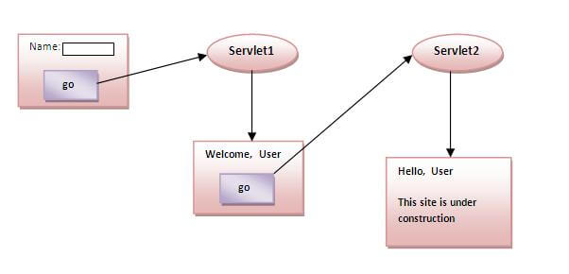
Simple example of Servlet Cookies

